Slide 1
City Budget - Team A
Team Members: Toby Ueno, Deep Patel, Lucia Kisova, Thian Amarasekera

Slide 2
Project Information
Project Sponsor: City of Boston
Project Motivation: The City of Boston collects data every year regarding its operating budget and capital budget
Project Goal: To identify how the budget is spread across different departments and neighborhoods, and identify trends among the funded projects
Background Needed: The City of Boston provides the data regarding how it spends money in each department and for what category

Slide 3
Logistics
What we have done so far: We have met weekly to discuss our progress and potential areas to explore. Analyzed the given data to identify any overall trends
How work has been divided: We have divided work by choosing the work we would like to do for that week (analysis, reports, data collection, etc)
What data we have used: We have used the provided data given by the Spark team in our GitHub repository.
How we collected data: We collected data by utilizing the given data and utilizing the City of Boston Budget website to gather additional data regarding spending per year by department

Slide 4
Progress
Early Observations:
On average, the city budget increased by 5.59% per year
The top 10 highest spending programs have a relatively stable spending and budgeting history, with the highest spending program for the past 2 years being the BPS Operations program
Challenges encountered: One challenge was working with missing data in the provided data, which is formatted differently and therefore requires extra steps to work with

Slide 5
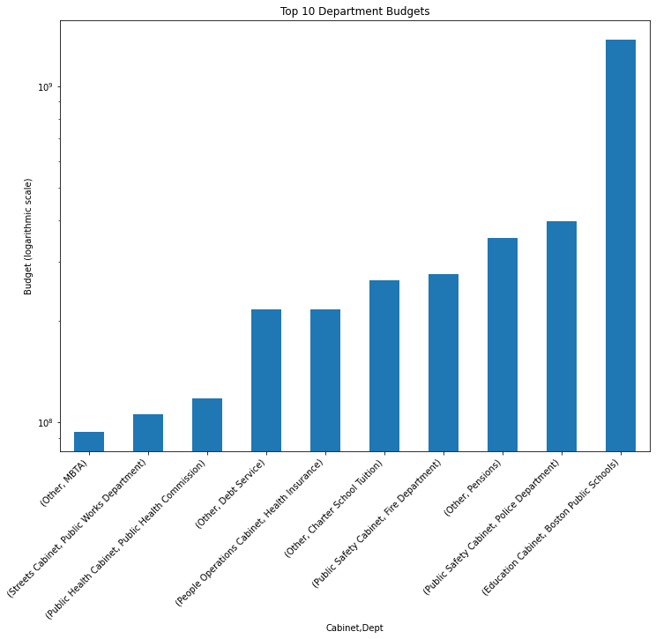
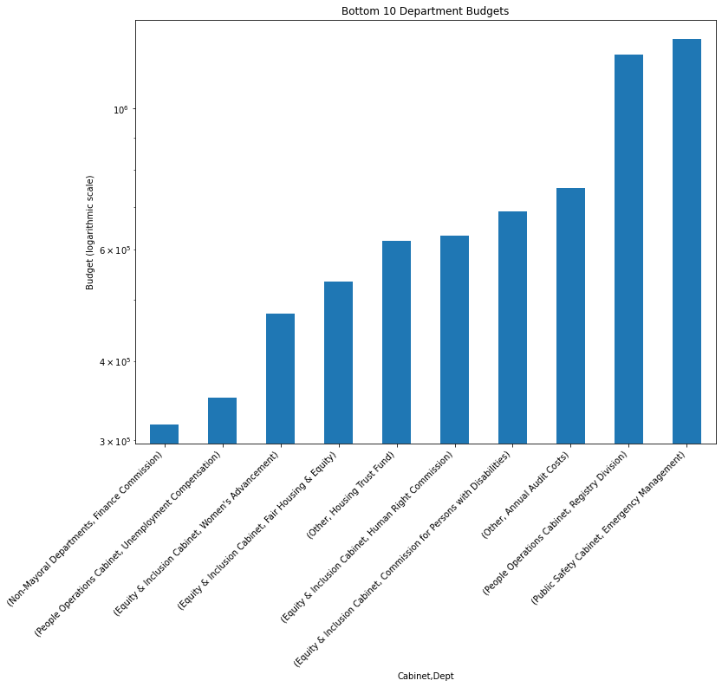
Visuals

Slide 6
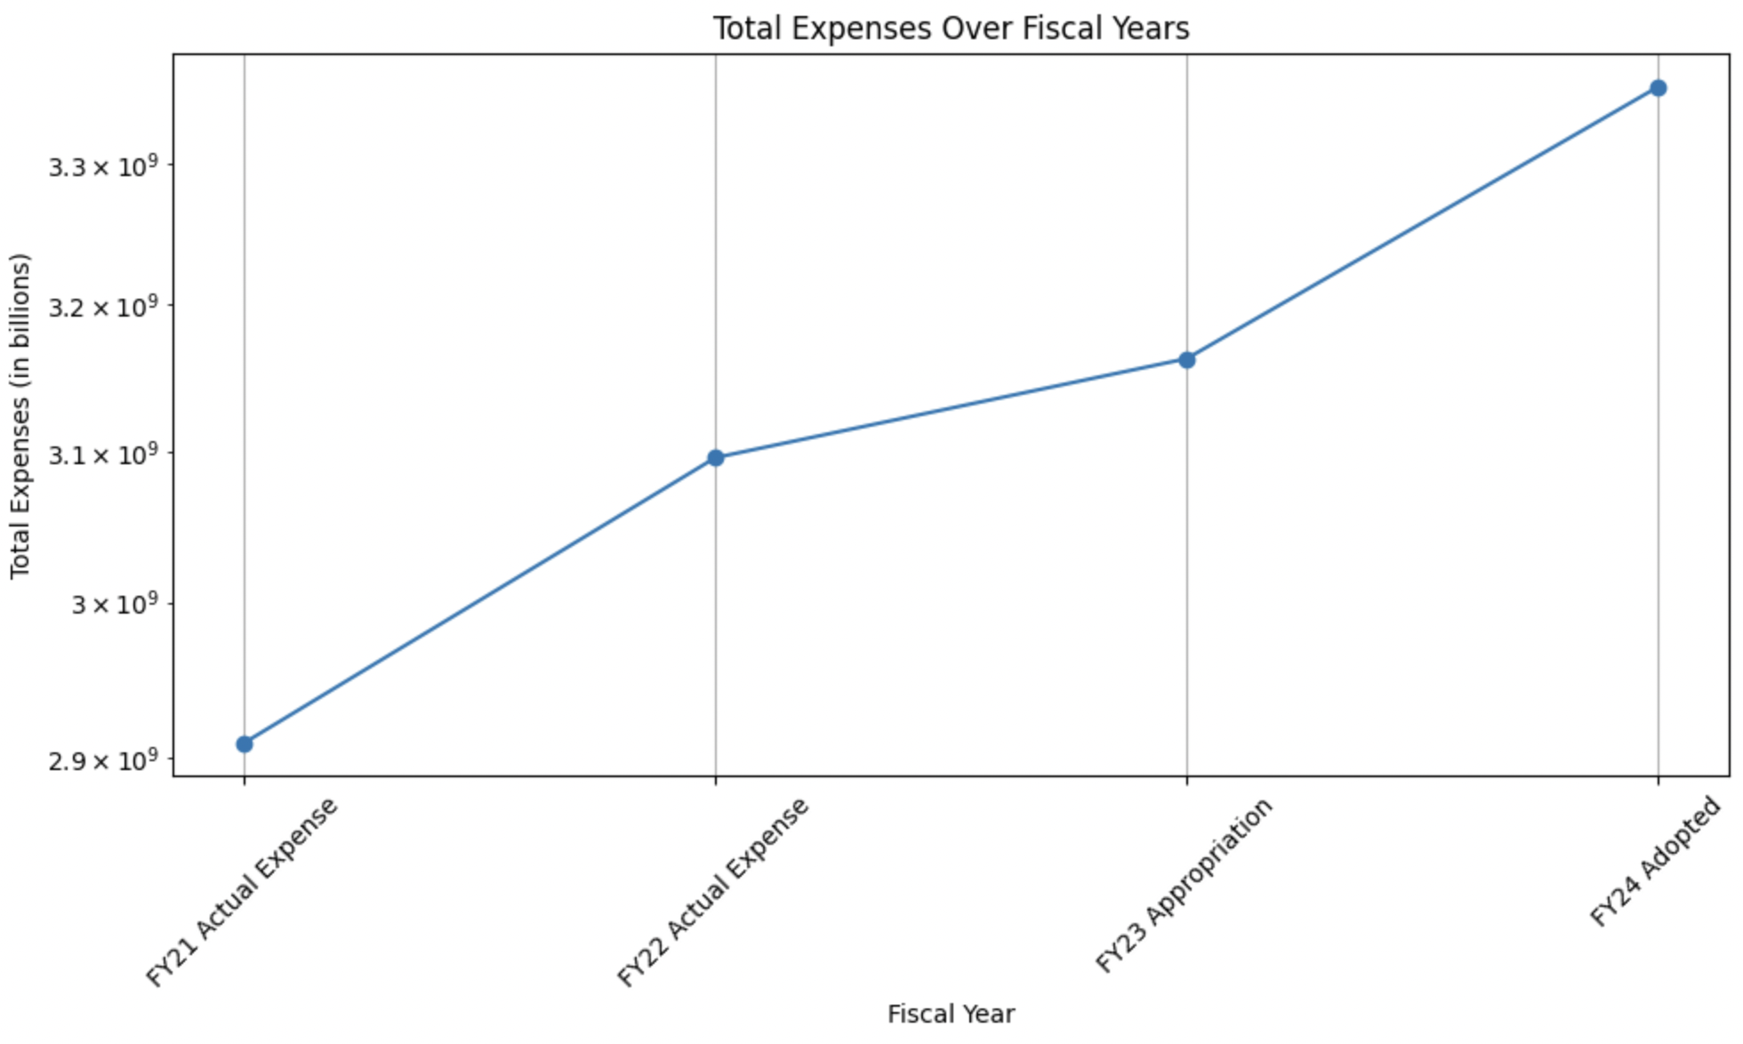
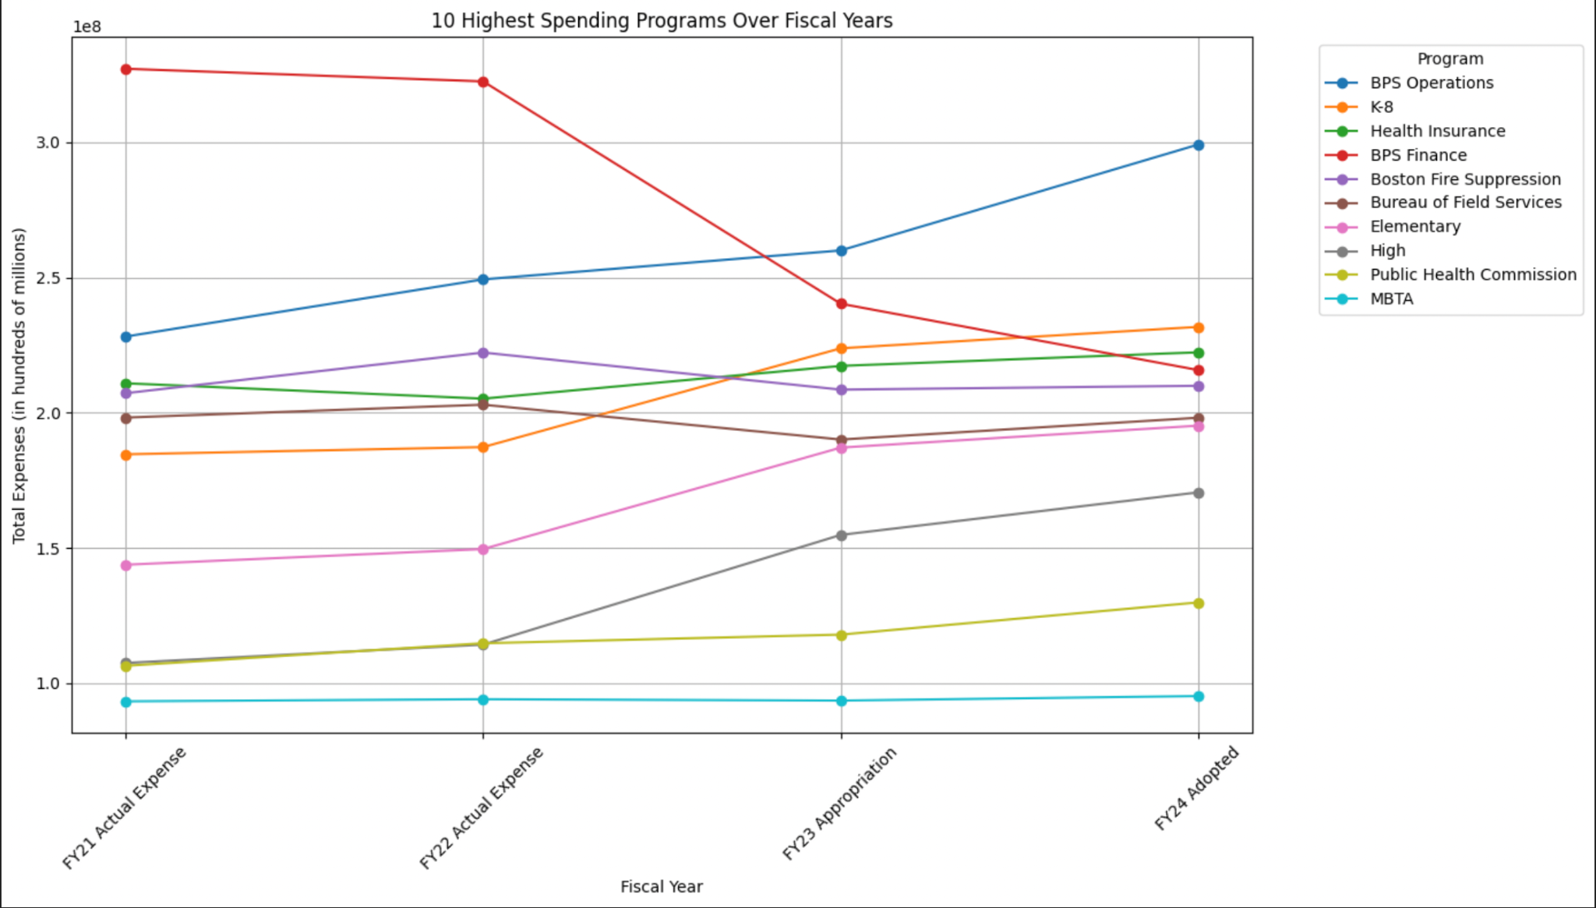
Visuals

Slide 7
Limitations & Challenges
Challenges faced:
Predicting budget trends accurately is challenging due to the influence of numerous unpredictable factors, such as economic conditions and political decisions
Limitations encountered:
Building models that capture all relevant variables without becoming overly complex is a difficult balancing task
Assumptions made:
Assuming provided budget data is accurate to a reasonable degree, includes all essential variables and consistency in data formatting
Proposed next steps:
Addressing all base project related key questions and submitting the extension proposal

Slide 8
Extension Proposal
Extension Pitch: We will be identifying trends among neighborhoods and how spending per capita differs by neighborhood
Importance: This is important because it can reveal information regarding how spending differs by neighborhood as a function of population density. This is interesting because these expenditures are often the most visible to residents of local communities
Questions for Analysis: We hope to find a trend among neighborhoods that have a higher spending per capita. We are curious at what similarities we might find among these areas. We hypothesize that these neighborhoods may be closer together and have a smaller population density
Datasets Used: The City of Boston provides data regarding the population per neighborhood. We will be using the names of the neighborhoods and amount of people
Data Visualization: We hope to be able to create a map of Boston showing spending per capita for each neighborhood
Additional Information: One thing that would be very helpful is to have access to data pertaining to population per neighborhood and spending per neighborhood for the same year(s). Right now the data we have access to don't match in the year that they are providing data for, which can lead to inaccurate results
Notes:
https://data.boston.gov/dataset/neighborhood-demographics/resource/d8c23c6a-b868-4ba4-8a3b-b9615a21be07

